Slide 1
Introduction to Deep Learning & The Autoencoder
Artificial Intelligence
November 11, 2019

Slide 2
Our Plan
11/11/2019 | Deep Learning | Introduction to Deep Learning + Autoencoders
11/13/2019 | Neural Networks | Quiz | Quiz 4 (Neural Networks)
11/18/2019 | Deep Learning | Deep MLPs and CNNs
11/20/2019 | Deep Learning | Sequence Learning & LSTMs | Assignment 4 (Neural Networks) - due 11/22
11/25/2019
11/27/2019
12/02/2019 | Deep Learning | Deep Learning in Practice
12/04/2019 | AI Ethics & Society | TBD | Debate Prep
12/09/2019 | Deep Learning | Quiz | Quiz 5

Slide 3
Quiz 4 (Wednesday – 11/13)
Topic | Materials
Intro to ANNs and the Perceptron | Yoshimi CH 1&2 & 3 (highlighted sections) and Slides
Recurrent Networks (Hopfield) | Hopfield Handout and Slides (Yoshimi CH6 is Optional)
Feedforward Networks (Backprop) | Backprop Worked Example, Slides, and PerceptronLearn.xlsx (Yoshimi CH 7-9 is optional)
Competitive Learning (Kohonen Self-organizing map) | KohonenSOMWorkedExample and Slides (Yoshimi CH 10 is optional)

Slide 4
Quiz 4: Content
Conceptual knowledge of basic concepts (perceptron, activation function, recurrent network, hidden layers, pattern association, competitive learning, Hebbian learning, etc)
To prepare: Carefully read over the slides and readings and self-explain
Detailed understanding of three major algorithms (Backprop; Hopfield network; Kohonen SOM)
Will be asked to perform operations on simple networks (e.g., given network with inputs compute output and adjust weights; store memories in Hopfield network)
Go through the worked examples and in-class activities, then complete the take-home practice

Slide 5
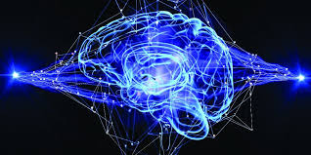
Deep Neural Learning
Intro to Deep Learning & Autoencoders
Convolutional Neural Networks
Deep Sequence Learning
Deep Learning in Practice

Slide 6
Agenda
Intro to Deep Learning
In-class activity
Autoencoders

Slide 8
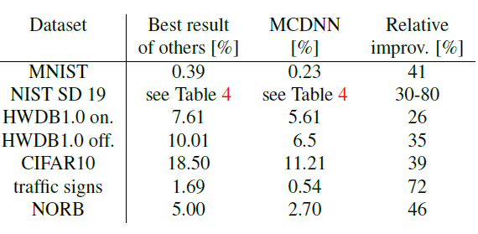
Deep Learning is providing breakthrough results in speech recognition and image classification …
From this Hinton et al 2012 paper:
http://static.googleusercontent.com/media/research.google.com/en//pubs/archive/38131.pdf
go here: http://yann.lecun.com/exdb/mnist/
From here:
http://people.idsia.ch/~juergen/cvpr2012.pdf
[slides adapted from Prof. Corne]

Slide 9
So, 1. what exactly is deep learning ?
And, 2. why is it generally better than other methods on image, speech, and certain other types of data?

Slide 10
So,
what exactly is deep learning ?
why is it generally better than other methods on image, speech and certain other types of data?
The short answers
‘Deep Learning’ means using a neural network with several layers of nodes between input and output
The series of layers between input & output do feature identification and processing in a series of stages, just as our brains seem to.

Slide 11
multilayer neural networks have been around for
25 years. What’s actually new?

Slide 12
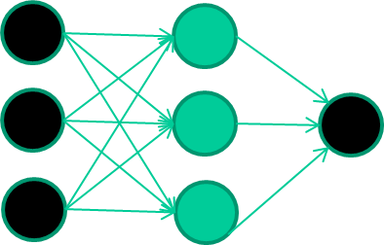
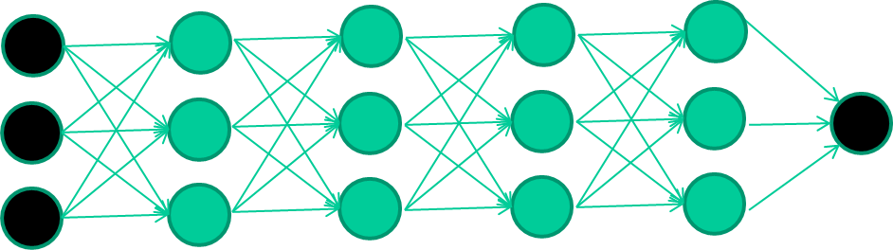
multilayer neural networks have been around for
25 years. What’s actually new?
we have always had good algorithms for learning the
weights in networks with 1-2 hidden layers
but these algorithms are not good at learning the weights for
networks with more hidden layers
what’s new is: algorithms for training many-layer networks

Slide 13
key ideas
the idea of unsupervised feature learning (why ‘intermediate features’ are important for difficult classification tasks, and how NNs seem to naturally learn them)
The ‘breakthrough’ – the simple trick for training Deep neural networks

Slide 14
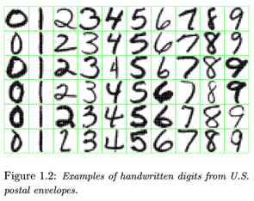
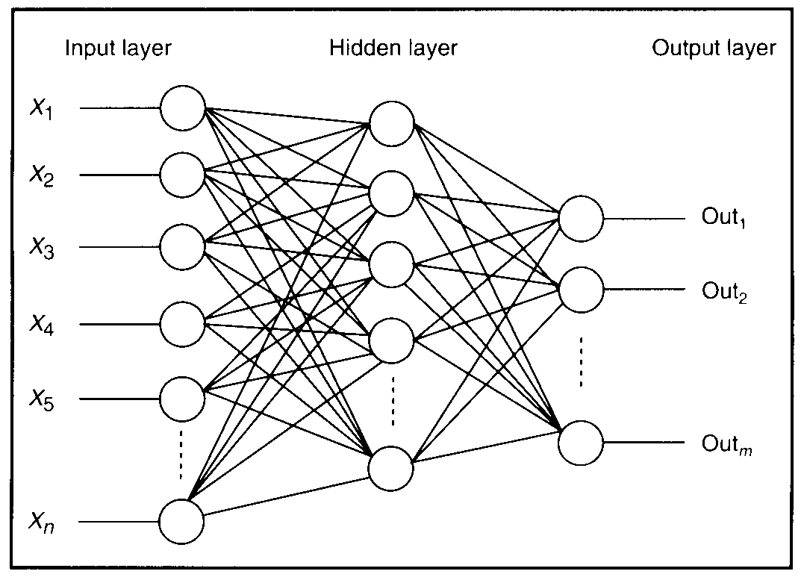
Feature detectors

Slide 15
what is this unit doing?

Slide 16
Hidden layer units become self-organised feature detectors
1 5 10 15 20 25 …
…
1
strong +ve weight
low/zero weight
63

Slide 17
What does this unit detect?
1 5 10 15 20 25 …
…
1
strong +ve weight
low/zero weight
63

Slide 18
What does this unit detect?
1 5 10 15 20 25 …
…
1
strong +ve weight
low/zero weight
it will send strong signal for a horizontal
line in the top row, ignoring everywhere else
63

Slide 19
What does this unit detect?
1 5 10 15 20 25 …
…
1
strong +ve weight
low/zero weight
63

Slide 20
What does this unit detect?
1 5 10 15 20 25 …
…
1
strong +ve weight
low/zero weight
Strong signal for a dark area in the top left
corner
63

Slide 21
What features might you expect a good NN
to learn, when trained with data like this?

Slide 22
Vertical lines
1
63

Slide 23
Horizontal lines
1
63

Slide 24
Small circles
1
63

Slide 25
Small circles
1
But what about position invariance ???
our example unit detectors were tied to
specific parts of the image
63

Slide 26
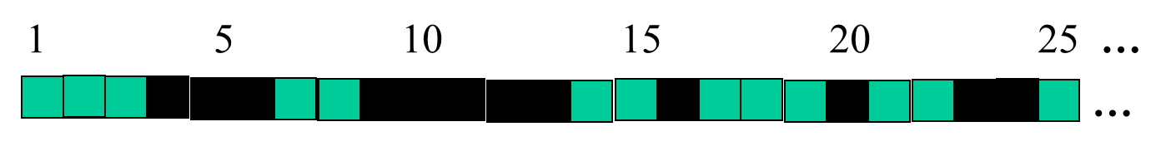
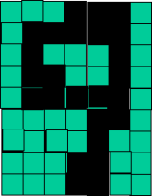
successive layers can learn higher-level features …
detect lines in
specific positions
etc …
Higher level detectors
detect at any position
( horizontal line,
“RHS vertical line”
“upper loop”, etc…)
etc …
v

Slide 27
successive layers can learn higher-level features …
detect lines in
Specific positions
etc …
Higher level detetors
( horizontal line,
“RHS vertical lune”
“upper loop”, etc…
etc …
v
What does this unit detect?

Slide 28
So: multiple layers make sense

Slide 29
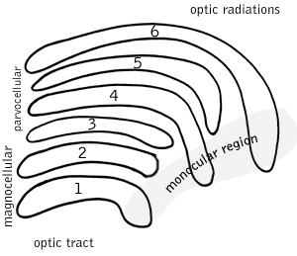
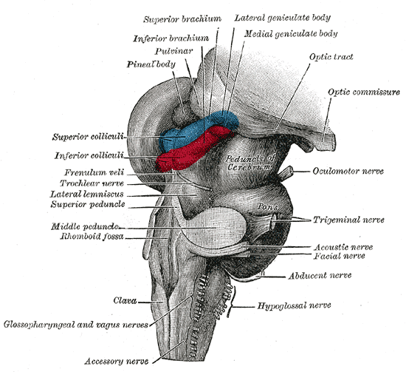
So: multiple layers make sense
Your brain works that way

Slide 30
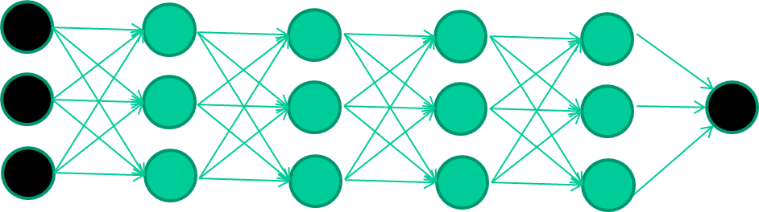
So: multiple layers make sense
Many-layer neural network architectures should be capable of learning the true underlying features and ‘feature logic’, and therefore generalise very well …

Slide 31
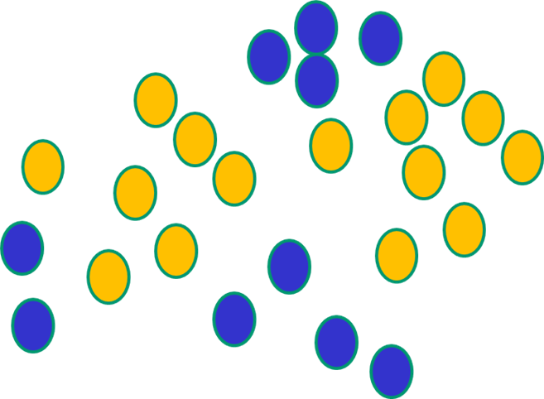

But, until very recently, our weight-learning algorithms simply did not work on multi-layer architectures

Slide 32
The new way to train multi-layer NNs…

Slide 33
The new way to train multi-layer NNs…
Train this layer first

Slide 34
The new way to train multi-layer NNs…
Train this layer first
then this layer

Slide 35
The new way to train multi-layer NNs…
Train this layer first
then this layer
then this layer

Slide 36
The new way to train multi-layer NNs…
Train this layer first
then this layer
then this layer
then this layer

Slide 37
The new way to train multi-layer NNs…
Train this layer first
then this layer
then this layer
then this layer
finally this layer

Slide 38
The new way to train multi-layer NNs…
EACH of the (non-output) layers is trained to be an auto-encoder
Basically, it is forced to learn good features that describe what comes from the previous layer

Slide 39
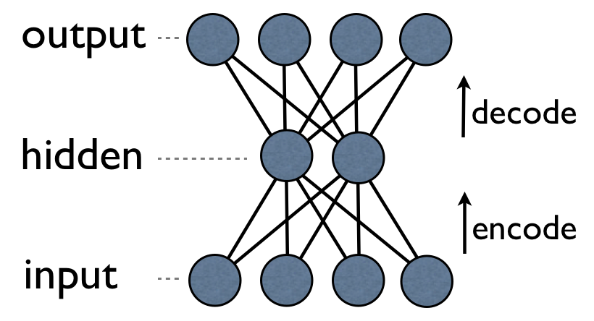
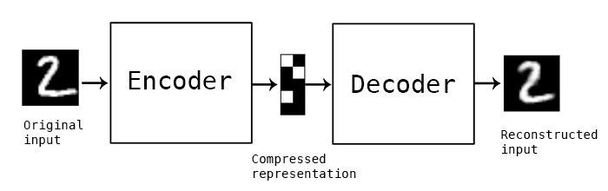
an auto-encoder is trained, with an absolutely standard weight-adjustment algorithm (backprop) to reproduce the input

Slide 40
an auto-encoder is trained, with an absolutely standard weight-adjustment algorithm to reproduce the input
By making this happen with (many) fewer units than the inputs, this forces the ‘hidden layer’ units to become good feature detectors

Slide 41
intermediate layers are each trained to be auto encoders (or similar)

Slide 42
Final layer trained to predict class based on outputs from previous layers

Slide 43
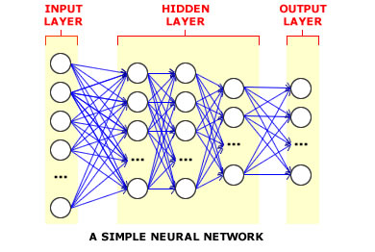
And that’s that
That’s the basic idea
There are many types of deep learning,
Different kinds of autoencoder, variations on architectures and training algorithms, etc…
Very fast growing area …

Slide 44
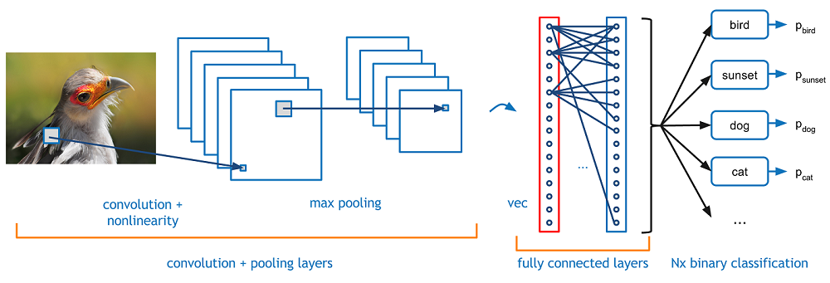
Convolutional neural networks

Slide 45
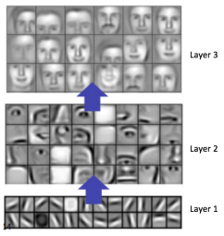
Convolutional neural networks

Slide 46
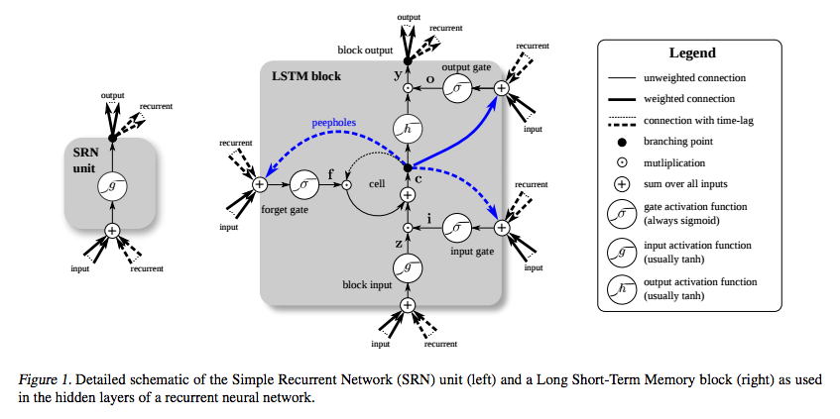
Long short term memory networks

Slide 47
Deep Learning in the Context of AI

Slide 48
How did we get here?

Slide 49
Enabling Factors: Increasing Dataset Sizes

Slide 50
Enabling Factors: Increasing Computational Model Sizes

Slide 51
Enabling Factors: Increasing Computational Model Sizes

Slide 52
Enabling Factors: Improved Performance on Real-World Datasets

Slide 53
in-class activity https://cs.stanford.edu/people/karpathy/convnetjs/demo/regression.html

Slide 54
Autoencoders
Slides adapted from Prof. Guy Golan

Slide 57
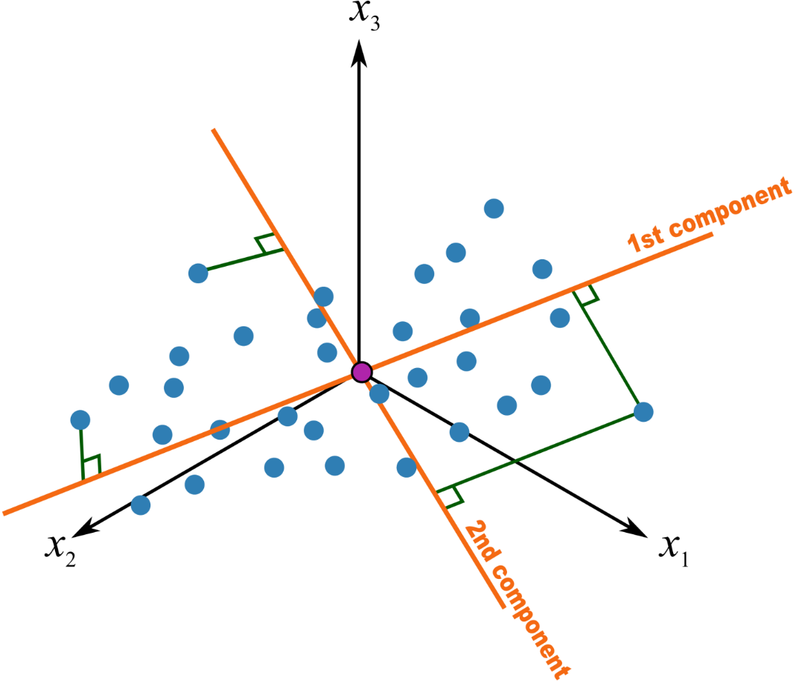
PCA – Principal Component analysis for data compression
Statistical approach for data compression and visualization
Invented by Karl Pearson in 1901
Weakness: linear components only.

Slide 58
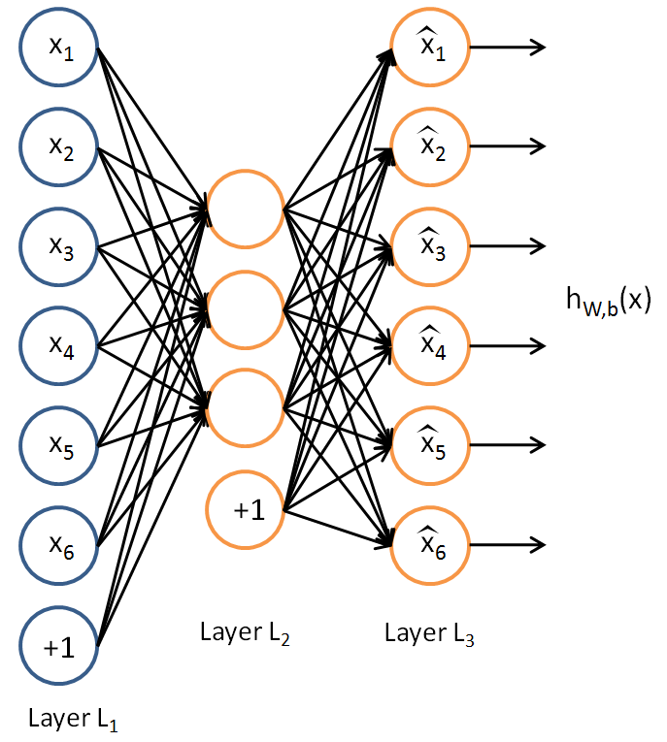
Uses
The autoencoder idea was a part of NN history for decades (LeCun et al, 1987).
Traditionally an autoencoder is used for dimensionality reduction and feature learning.
Can learn non-linear relations

Slide 59

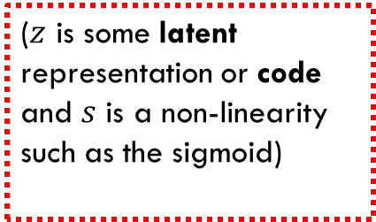

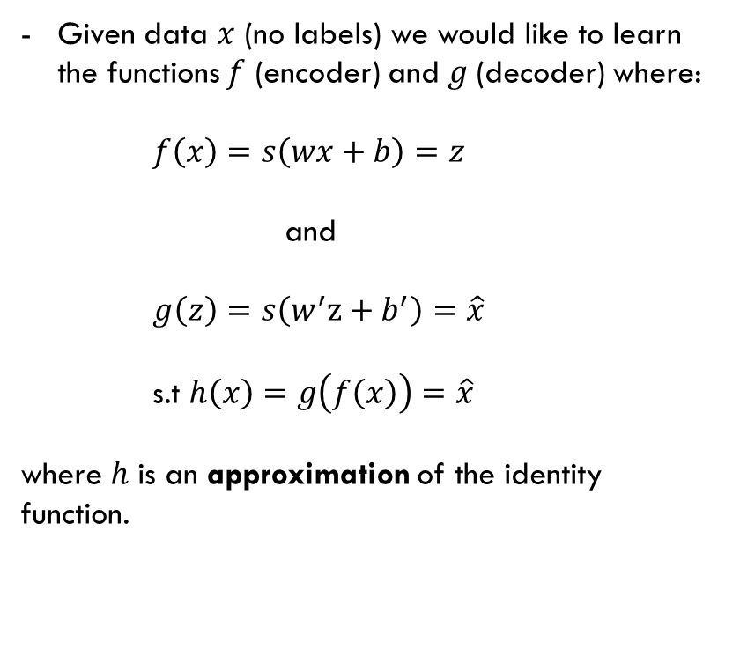




Simple Idea of Autoencoder
$$x$$
$$f\left(x\right)$$
$$z$$
$$g\left(z\right)$$
$$\hat{x}$$
Given data $x$ (no labels) we would like to learn the functions $f$ (encoder) and $g$(decoder) where:
$f\left(x\right)=s\left(wx+b\right)=z$
and
$g\left(z\right)=s\left(w^{′}z+b^{′}\right)=\hat{x}$
s.t $h\left(x\right)=g\left(f\left(x\right)\right)=\hat{x}$
where $h$ is an approximation of the identity function.
($z$ is some latent representation or code and $s$ is a non-linearity such as the sigmoid)
($\hat{x}$ is $x$’s reconstruction)

Slide 60
Undercomplete AE VS overcomplete AE
We distinguish between two types of AE structures:

Slide 61





Overcomplete AE
Hidden layer is Overcomplete if greater than the input layer
No compression in hidden layer.
Each hidden unit could copy a different input component.
$$\hat{x}$$
$$w′$$
$$f\left(x\right)$$
No guarantee that the hidden units will extract meaningful structure.
$$w$$
A higher dimension code helps model a more complex distribution.
$$x$$

Slide 62





Undercomplete AE
Hidden layer is Undercomplete if smaller than the input layer
Compresses the input
Compresses well only for the training dist.
$$\hat{x}$$
$$w′$$
$$f\left(x\right)$$
Hidden nodes will be
Good features for the training distribution.
Bad for other types on input
$$w$$
$$x$$

Slide 63





Example
$$z_{1}$$
Encoder
$$z_{2}$$
Encoder

Slide 64


Denoising Autoencoders
Intuition:
We still aim to encode the input and to NOT mimic the identity function.
We try to undo the effect of corruption process stochastically applied to the input.
A more robust model
Encoder
Decoder
Noisy Input
Latent space representation
Denoised Input

Slide 65
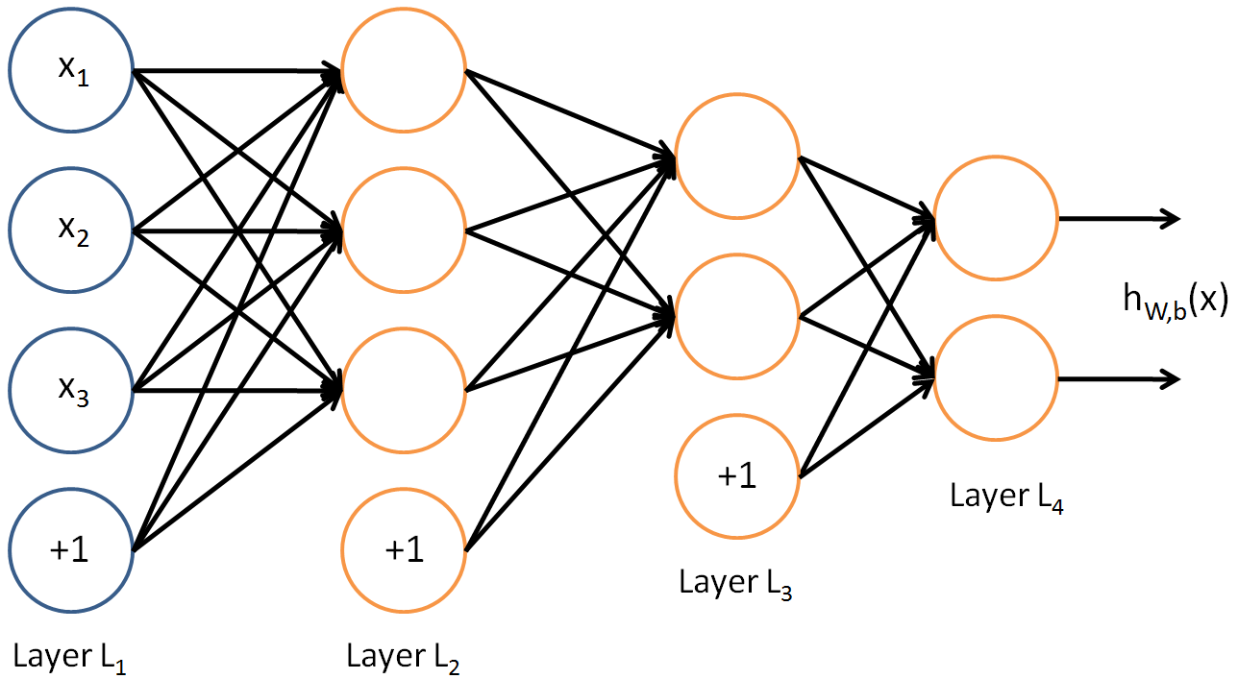
Denoising Autoencoders
Use Case:
Extract robust representation for a NN classifier.
Encoder
Noisy Input
Latent space representation

Slide 66
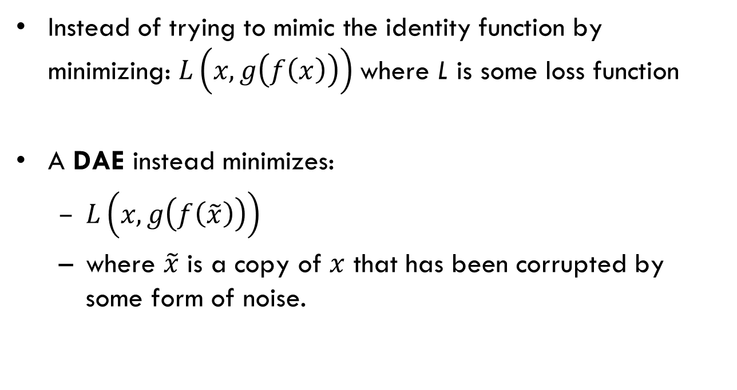
Denoising Autoencoder (DAE)
Instead of trying to mimic the identity function by minimizing: $L\left(x,g\left(f\left(x\right)\right)\right)$where L is some loss function
A DAE instead minimizes:
$L\left(x,g\left(f\left(\tilde{x}\right)\right)\right)$
where $\tilde{x}$ is a copy of $x$ that has been corrupted by some form of noise.

Slide 67




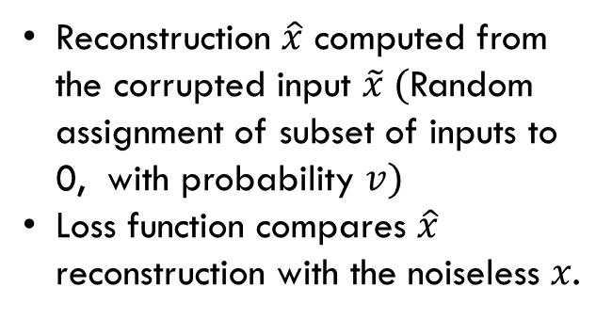

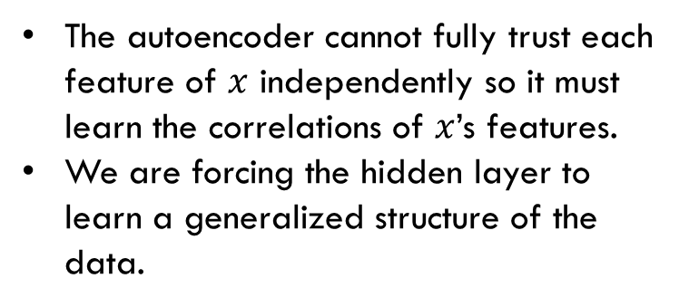

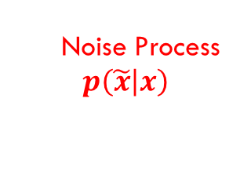
Denoising Autoencoders
$$\hat{x}$$
Reconstruction $\hat{x}$ computed from the corrupted input $\tilde{x} ($Random assignment of subset of inputs to 0, with probability $v)$
Loss function compares $\hat{x}$ reconstruction with the noiseless $x$.
$$w′$$
$$f\left(\tilde{x}\right)$$
$$w$$
The autoencoder cannot fully trust each feature of $x$ independently so it must learn the correlations of $x$’s features.
We are forcing the hidden layer to learn a generalized structure of the data.
$$\tilde{x}$$
0
0
0
Noise Process
$$p\left(\left.\tilde{x}\right|x\right)$$
$$x$$

Slide 68
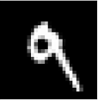






Denoising Autoencoders - process
Taken some input $x$
Apply Noise
$$\tilde{x}$$
$$\hat{x}$$
Compare
$$x$$
Get output

Slide 69





Stacked AE
First Layer Training (AE 1)
$$x$$
$$f_{1}\left(x\right)$$
$$z_{1}$$
$$g_{1}\left(z_{1}\right)$$
$$\hat{x}$$

Slide 70





Stacked AE
Second Layer Training (AE 2)
$$x$$
$$f_{1}\left(x\right)$$
$$z_{1}$$
$$f_{2}\left(z_{1}\right)$$
$$z_{2}$$
$$g_{2}\left(z_{2}\right)$$
$${\hat{z}}_{1}$$

Slide 71
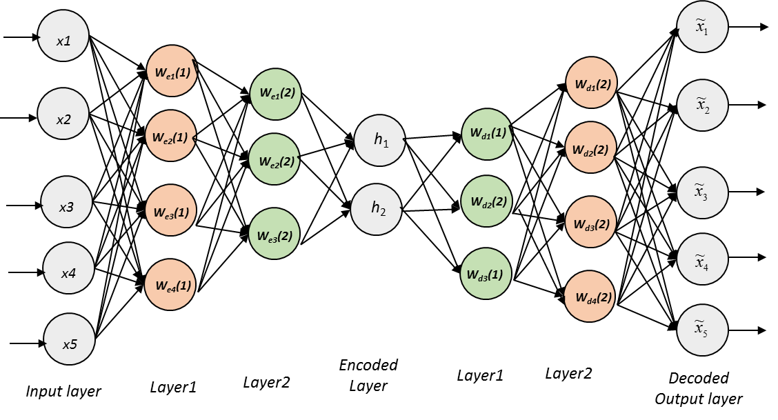
Stacked Autoencoder

Slide 72
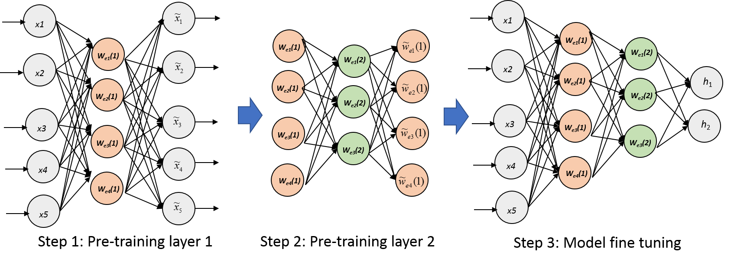
Layers are Trained One at a Time

Slide 73
Summary
Considered to be a form of representation learning
An autoencoder extracts a code (representation) of the input
The code (activation of encoded hidden layer) is used as input features for subsequent tasks
Pre-training via an auto-encoder helps a subsequent network learn better (it constrains the weight space)
Adding noise to the training process improves generalization (denoising autoencoder)
Better representations can be learned by stacking layers (stacked autoencoder)

Slide 74
Demos
Denoising autoencoder
https://cs.stanford.edu/people/karpathy/convnetjs/demo/autoencoder.html

Slide 75
Quiz 3 Scores
Individual – 5.75/7.5
Group – 6.65/7.5
Overall - 6.01/7.5

